Slide 1
Machine Learning Foundations Logistic Regression
Mingshan
August 20, 2020

Slide 2
Table of Contents
Two types of prediction
Logistic regression model
Cost function of logistic regression
Gradient descent of logistic regression
Exercises in Notebook

Slide 3


Two types of prediction
The predict target is continuous valued → Regression problem
$$y ∈[5, 50]$$
the boston house-prices dataset
The predict target is discrete valued → Classification problem
$$y ∈\{0, 1\}$$
the breast cancer wisconsin dataset
$$y ∈\{0, 1, 2\}$$
the iris dataset
Notes:
examples:
binary classification(two classes: negative and positive class)
multiclassification

Slide 4
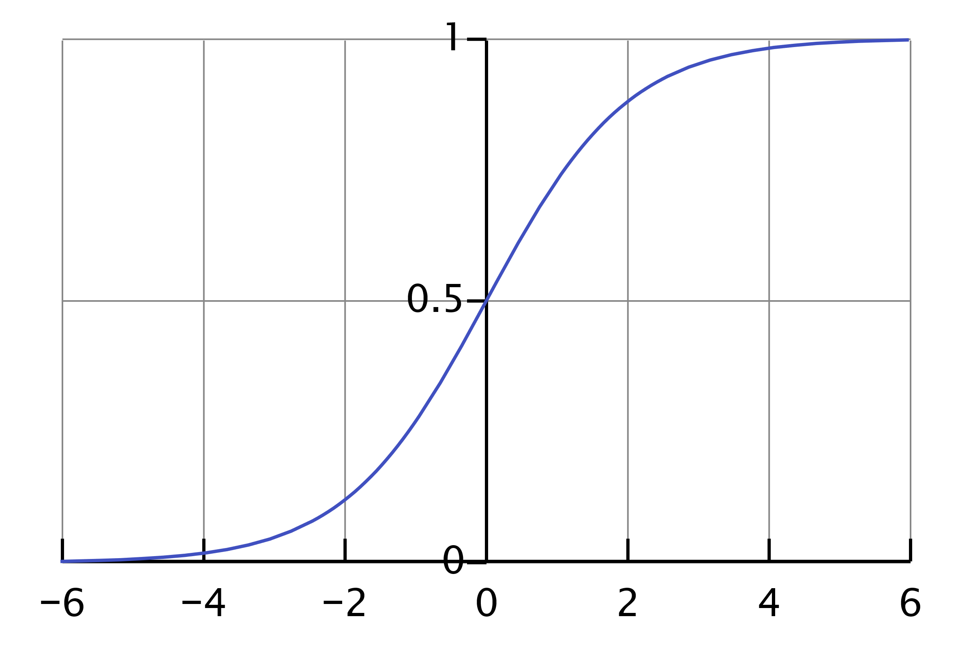
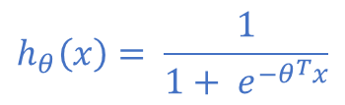
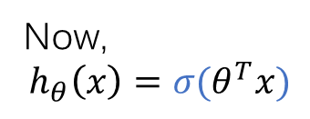
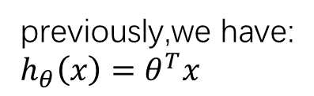
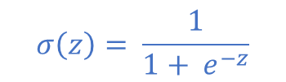
Sigmoid Function
$$σ\left(z\right)= \frac{1}{1+ e^{−z}}$$
previously,we have:
$$h_{θ}\left(x\right)=θ^{T}x$$
Now,
$$h_{θ}\left(x\right)={σ(θ}^{T}x)$$
$$h_{θ}\left(x\right)= \frac{1}{1+ e^{{−θ}^{T}x}}$$
Notes:
map z into the range of (0, 1)

Slide 5


Meaning of the hypothesis in Logistic Regression
$$h_{θ}\left(x\right)=P\left(y = 1\right| x; θ)$$
probability that y = 1, given x, parameterized by$θ$
$P\left(y =0\right| x; θ)$ = 1 - $P\left(y = 1\right| x; θ)$

Slide 6
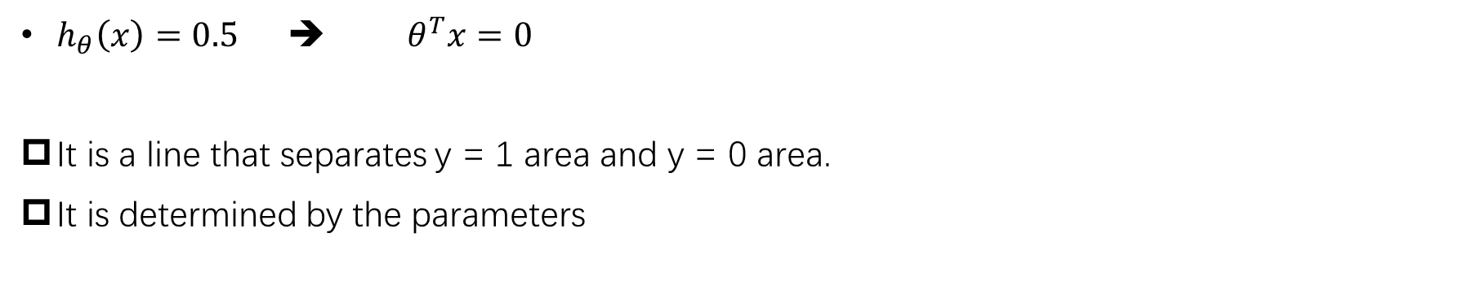
Decision Boundary
$h_{θ}\left(x\right)=0.5$ ➔ ${ θ}^{T}x=0$
It is a line that separates y = 1 area and y = 0 area.
It is determined by the parameters
Notes:
example

Slide 7


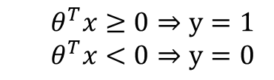
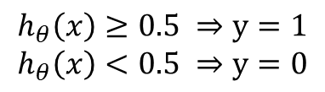

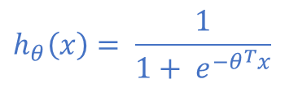
Logistic regression model
A modified hypothesis
A decision boundary
$$h_{θ}\left(x\right)=θ^{T}x$$
$$h_{θ}\left(x\right)≥0.5$$
${ θ}^{T}x≥0$
$$h_{θ}\left(x\right)≥0.5 ⇒y=1$$
$$h_{θ}\left(x\right)<0.5 ⇒y=0$$
or,
$${ θ}^{T}x≥0⇒y=1$$
$${ θ}^{T}x<0⇒y=0$$
$$h_{θ}\left(x\right)= \frac{1}{1+ e^{{−θ}^{T}x}}$$
Notes:
linear regression: weighted sum of features : all range of real number - infinity --- + infinity
+ logistic function (sigmoid function)

Slide 8

Cost Function
In linear regression model, we have defined a cost function:
$$J(θ)= \frac{1}{2m}\sum_{i=1}^{m}{{(h_{θ}\left(x^{\left(i\right)}\right)− y^{(i)})}^{2}}$$
Can we continue to this?
Notes:
non-convex, not guaranteed to converge to global minimum

Slide 9
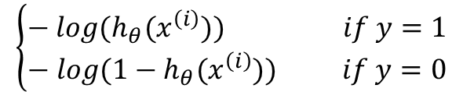
Cost Function of logistic regression
$J\left(θ\right)=\frac{1}{m}\sum_{i=1}^{m}{\left[−y^{\left(i\right)}log{(h}_{θ}\left(x^{\left(i\right)}\right)\right)−(1 − y^{\left(i\right)})log⁡(1 −h_{θ}(x^{(i)}))]}$
$$\left\{\begin{aligned}− log{(h}_{θ}(x^{\left(i\right)})) if y=1 \\ − log{(1−h}_{θ}(x^{\left(i\right)})) if y=0\end{aligned}\right.$$
Notes:
convex
draw two figures for each piece

Slide 10
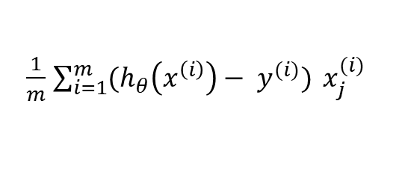

Gradient Descent for Logistic Regression
$Minimize J\left(θ\right) over θ$
repeat until $J(θ)$ converges to minimum:
$θ_{j}=θ_{j} − α\frac{∂}{∂θ_{j}}J(θ)$
$θ_{j}=θ_{j} − α\frac{1}{m}$ $\sum_{i=1}^{m}{(h_{θ}\left(x^{\left(i\right)}\right)− y^{(i)})} x_{j}^{(i)}$
$\frac{1}{m}$ $\sum_{i=1}^{m}{(h_{θ}\left(x^{\left(i\right)}\right)− y^{(i)})} x_{j}^{(i)}$
Notes:
h(x) has changed

Slide 11

Use the learned model to predict
$h_{θ}\left(x\right)= \frac{1}{1+ e^{{−θ}^{T}x}}$
$\hat{y}=\left\{\begin{aligned}1, if{ h}_{θ}(x)≥0.5 \\ 0, if{ h}_{θ}(x)<0.5\end{aligned}\right.$

